Slide 1


Reported by Fangyao
Date: April 22, 2024
Goodbye our dear Kitty, wish you all the best in meow star
Stray cat on UTSZ campus missing two weeks, has died from stick attack by campus employee after investigation

Slide 2

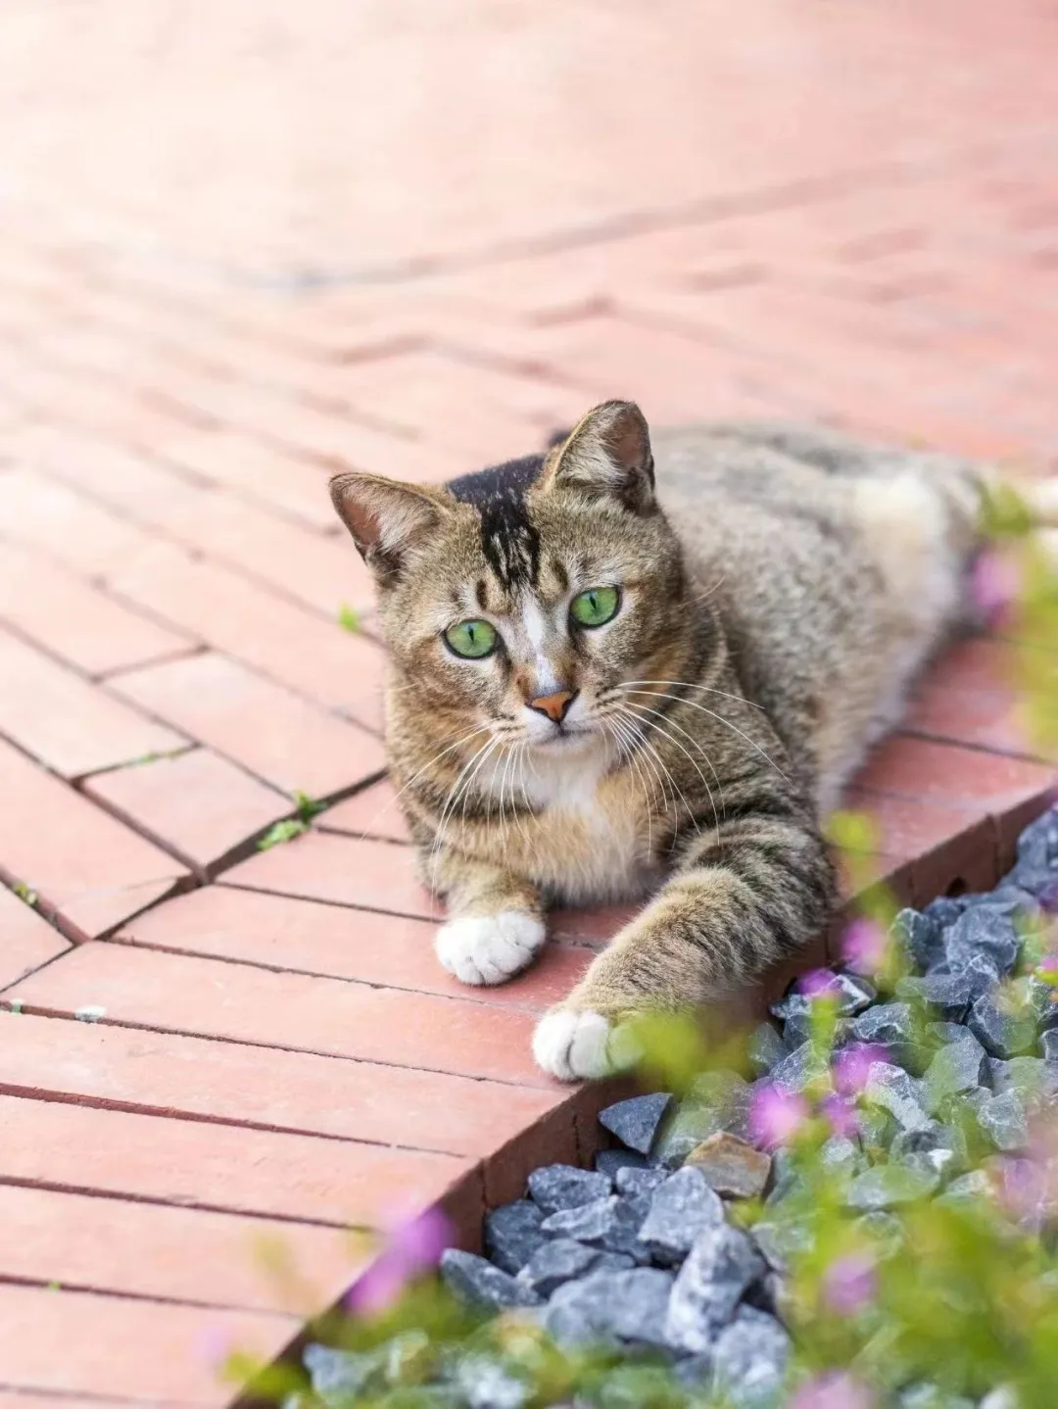


How did this happen?
The members of the stray cat association of UTSZ stood in front of the monitoring displayer for a long time, and saw a cat dying under the stick on the screen, they were very angry and confused, but eventually they calmed down and decided to find out the abuser as soon as possible, so that the abuser should be punished.

Slide 3

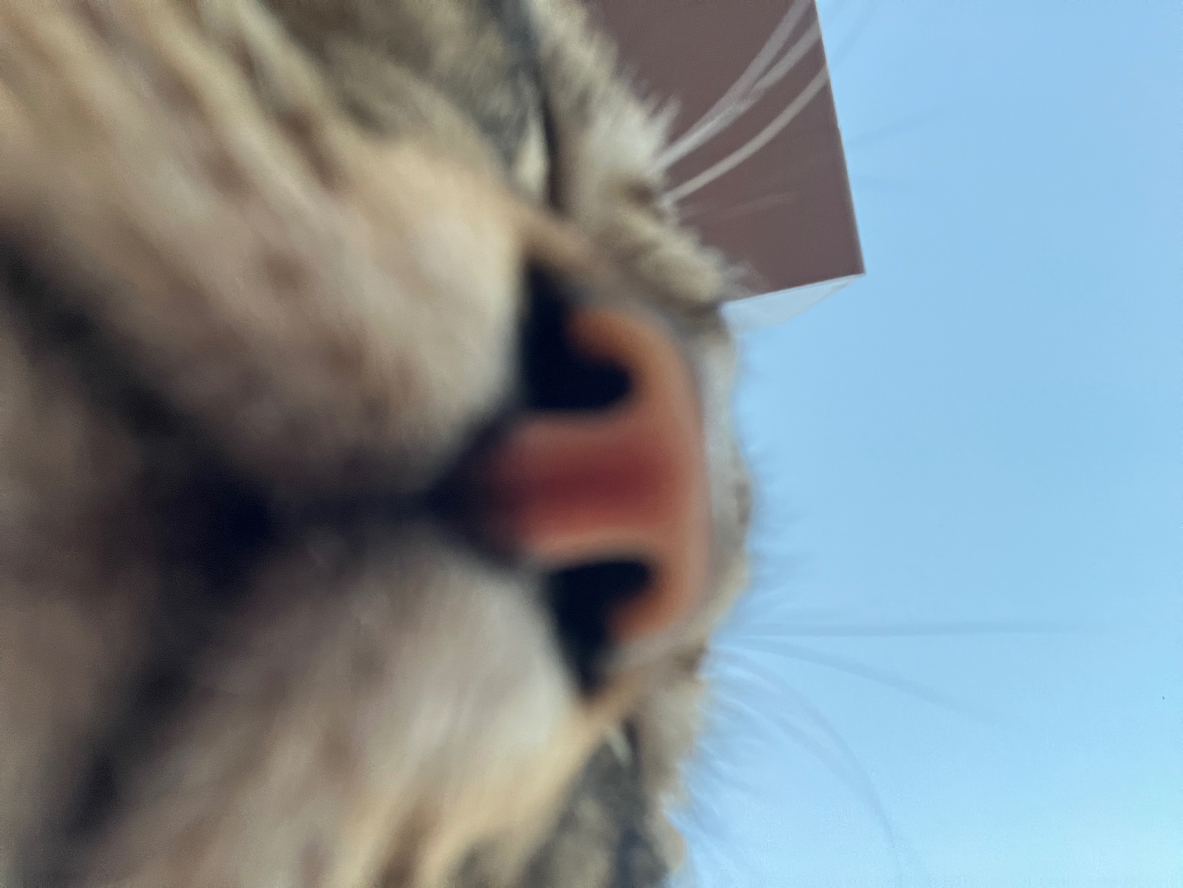
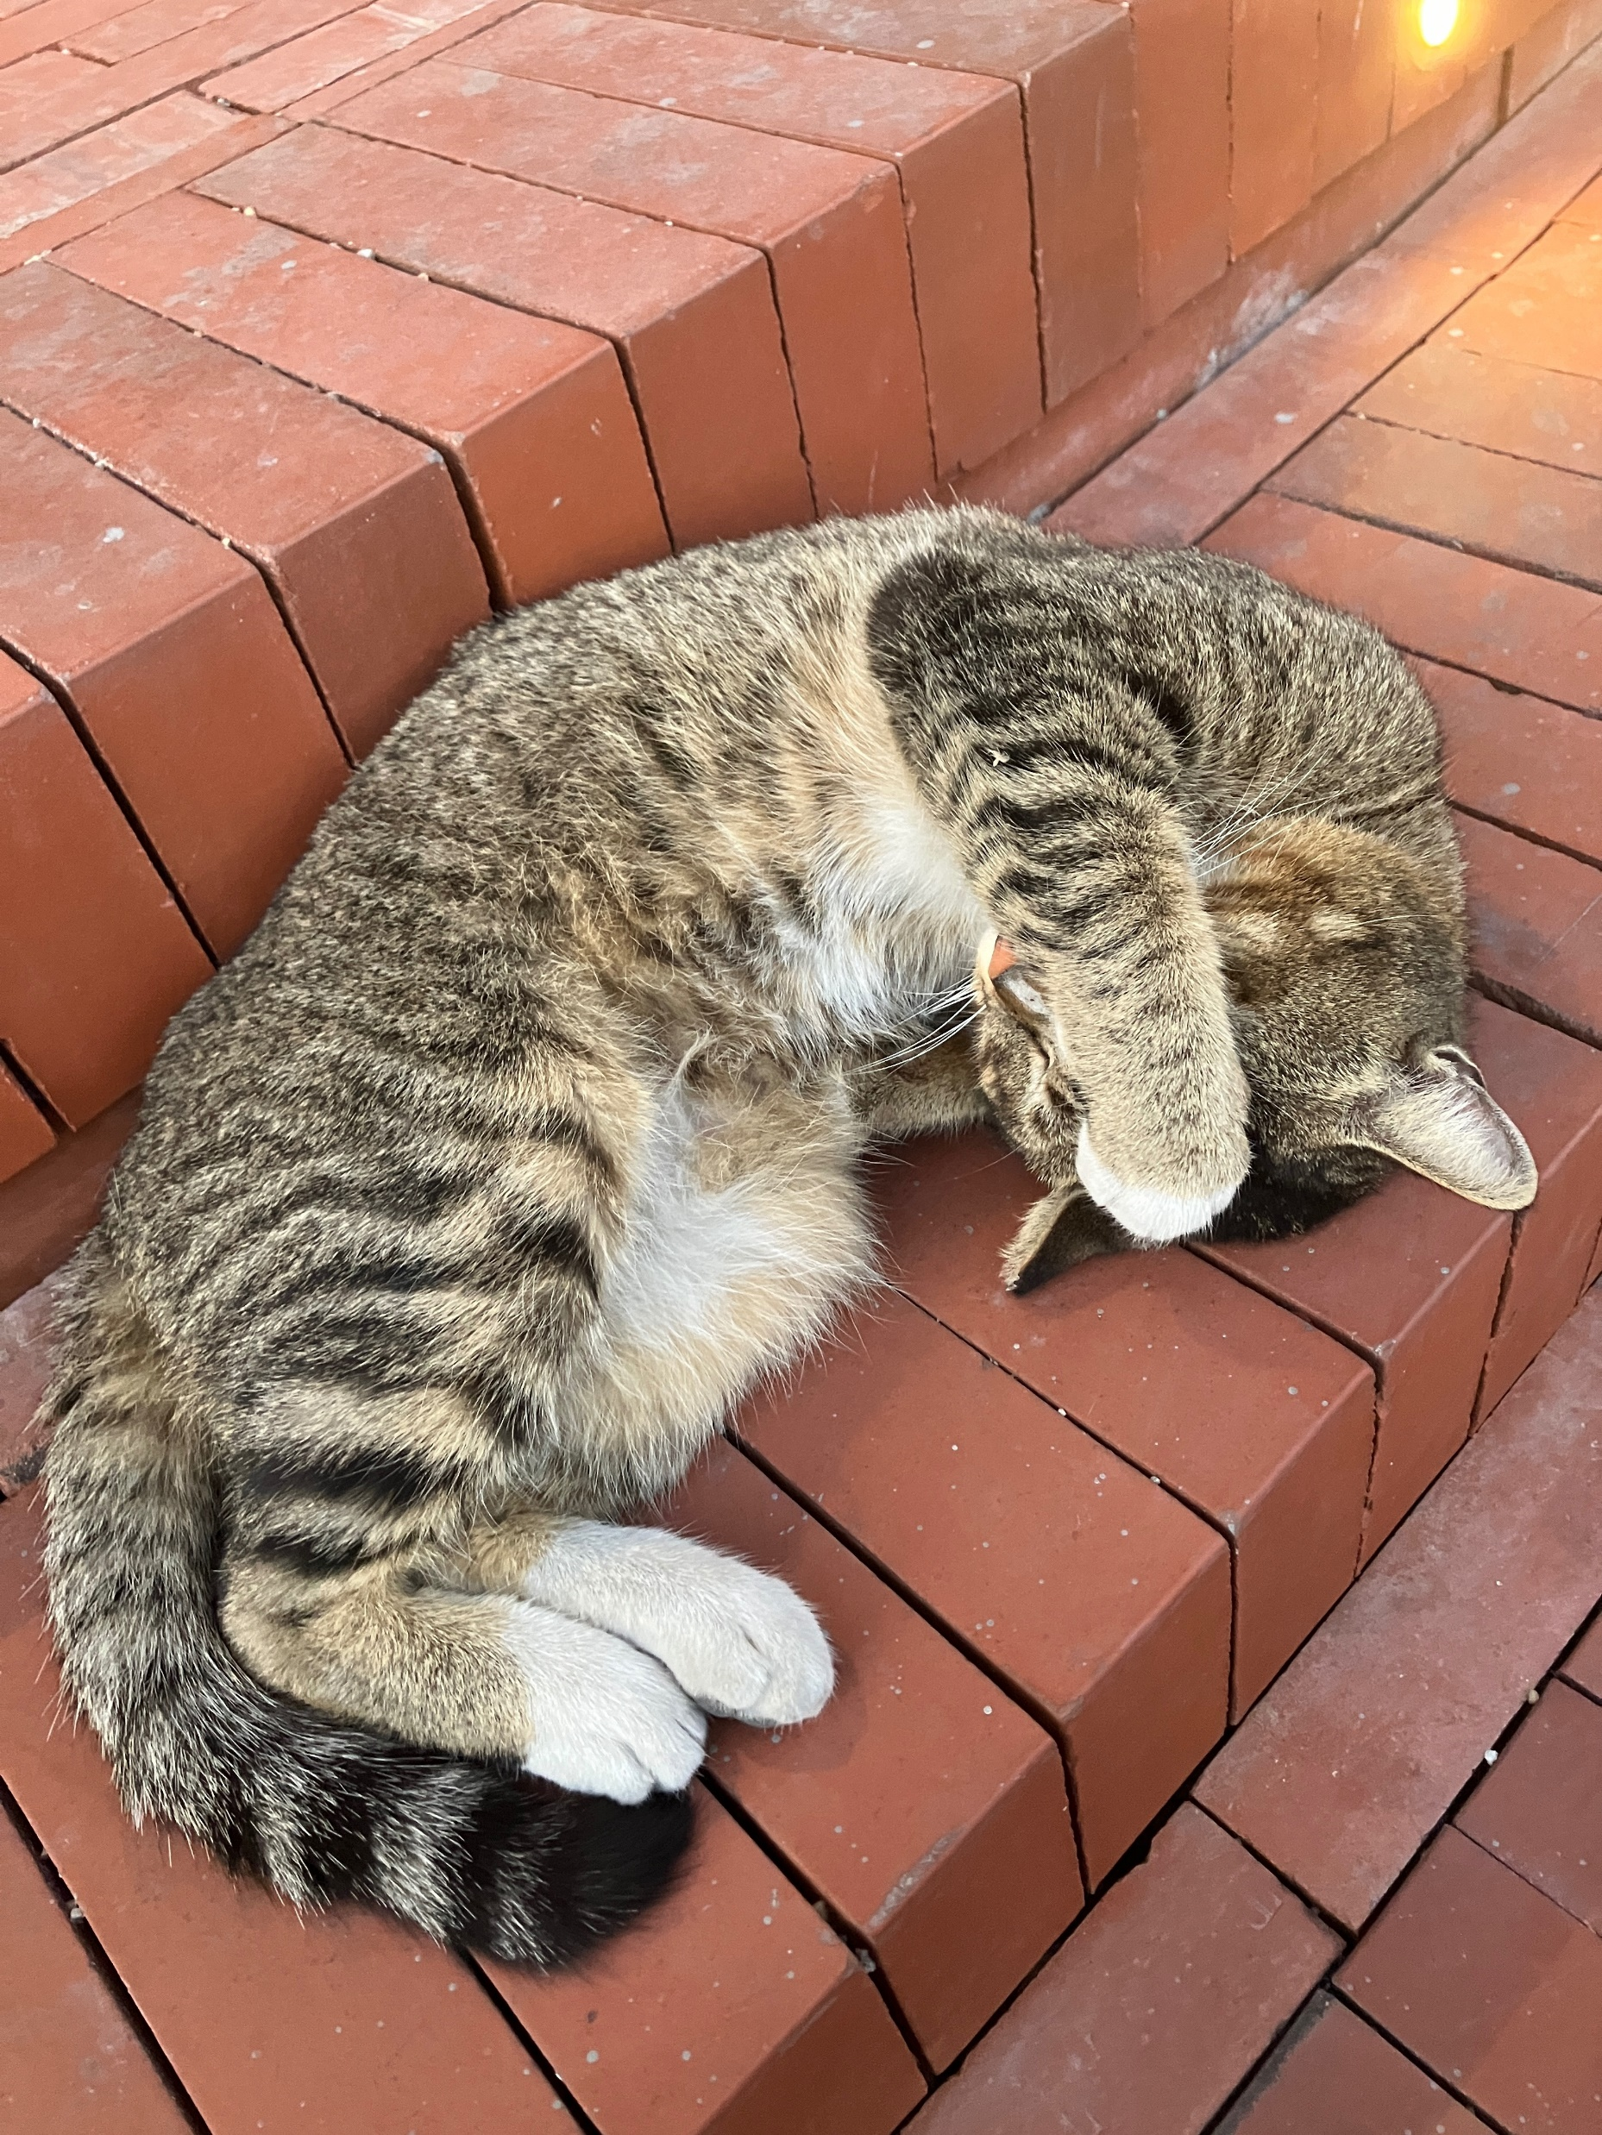
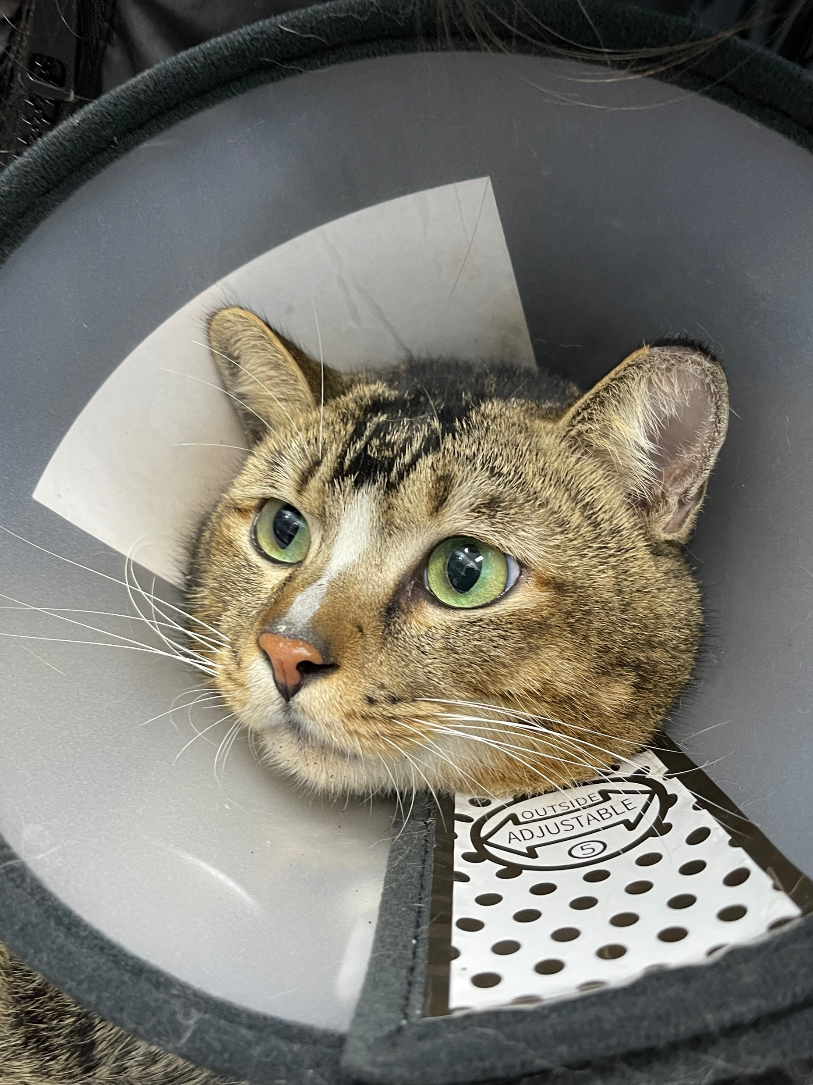
The facts of the incident come to light
On April 11, two weeks after the social butterfly (Chinese name Jiaojihua) disappeared, The students of the stray cat association of UTSZ applied to the police room to query the school surveillance video, but desperately found that the cat was beaten with a stick at about 16:30 on March 27. The man was targeted, cruel, got out of the car and walked straight towards the social butterfly sleeping on the ground. The kittens scattered around him, leaving the sleeping social girl incapacitated on the spot, who was loaded into his car without a struggle.

Slide 4
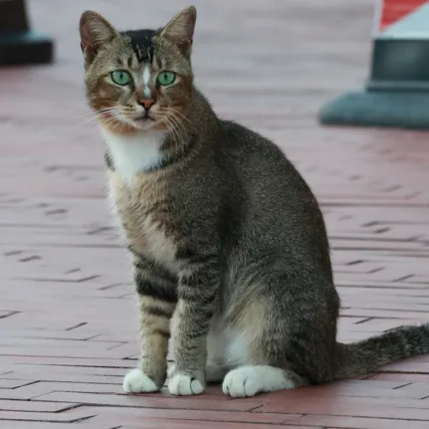
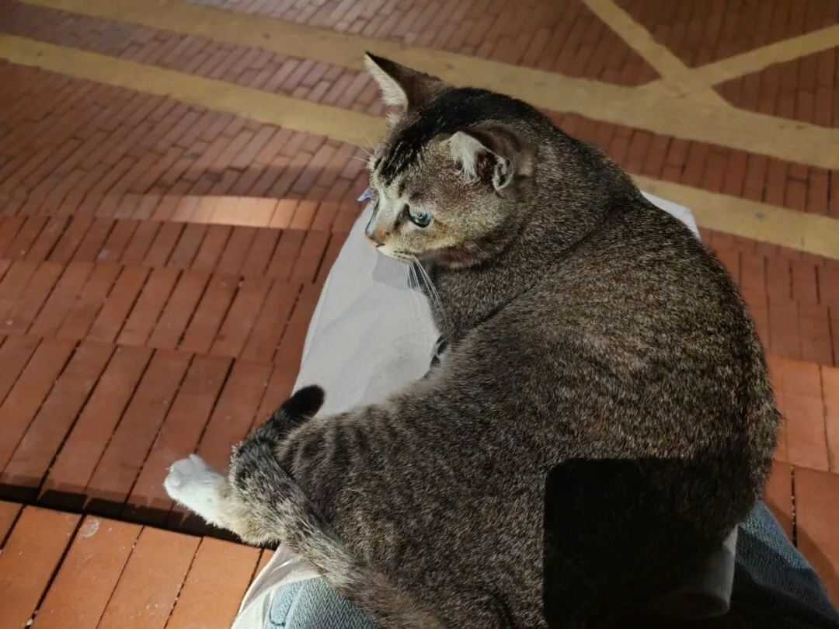
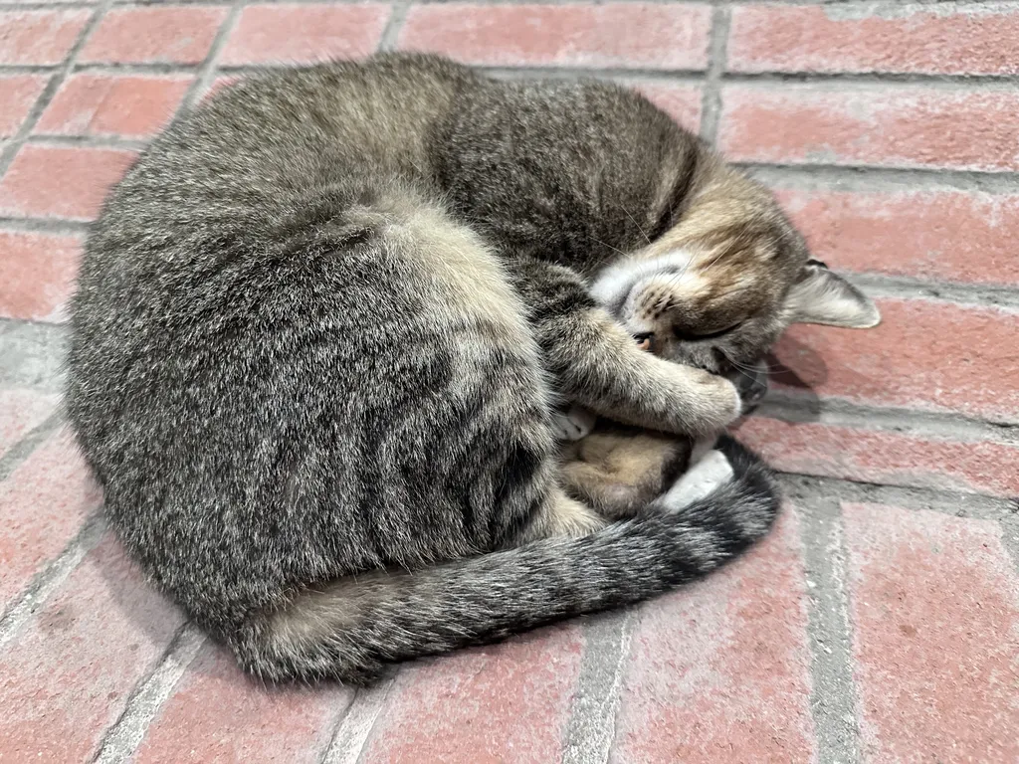
The facts of the incident come to light
After obtaining solid evidence, they immediately reported the case to the police station and the school security office. After multiple investigations, it was clear that the person's identity was not a teacher or student in school. The man confessed to beating the cat, claiming to have knocked it out and taken it to a garbage station for disposal. Teachers and students in the school angrily condemned such atrocities, and severely held them accountable. After a long negotiation and discussion, the perpetrators were finally punished:

Slide 5

The facts of the incident come to light
1. At the request of the students, the perpetrator wrote a handwritten apology letter, apologized to the teachers and students with his handprints, and promised not to hurt stray animals in the future;
2. The company where the perpetrator worked had fired him and reported the matter to the district Urban Management Bureau for severe punishment;
3. The school has put the perpetrator on the access control blacklist, permanently prohibiting the person from entering the school in the future to ensure the safety of the school.

Slide 6



Love and miss forever, until meet again
Many students are angry after hearing the news of cat's death. They miss the little bit with the social butterfly, who snored, rolled his belly, does not reach out the paws, was never afraid of people, escaped the cat plague at the beginning of the year, but did not escape the sticks of the bad guy.
At present, China's stray animal protection law is still in its infancy, and it is hoped that in the near future, bad people who abuse animals can be severely punished, instead of such light punishments of this incident.

Slide 7
summary
[kicker]Goodbye our dear Kitty, wish you all the best in meow star
Stray cat on UTSZ campus missing two weeks, has died from stick attack by campus employee after investigation
[Anecdotal lead]
How did this happen?
The members of the stray cat association of UTSZ stood in front of the monitoring displayer for a long time, and saw a cat dying under the stick on the screen, they were very angry and confused, but eventually they calmed down and decided to find out the abuser as soon as possible, so that the abuser should be punished.
[nut graph] and [body]
The facts of the incident come to light
On April 11, two weeks after the social butterfly (Chinese name Jiaojihua) disappeared, The students of the stray cat association of UTSZ applied to the police room to query the school surveillance video, but desperately found that the cat was beaten with a stick at about 16:30 on March 27. The man was targeted, cruel, got out of the car and walked straight towards the social butterfly sleeping on the ground. The kittens scattered around him, leaving the sleeping social girl incapacitated on the spot, who was loaded into his car without a struggle.
After obtaining solid evidence, they immediately reported the case to the police station and the school security office. After multiple investigations, it was clear that the person's identity was not a teacher or student in school. The man confessed to beating the cat, claiming to have knocked it out and taken it to a garbage station for disposal. Teachers and students in the school angrily condemned such atrocities, and severely held them accountable. After a long negotiation and discussion, the perpetrators were finally punished:
1. At the request of the students, the perpetrator wrote a handwritten apology letter, apologized to the teachers and students with his handprints, and promised not to hurt stray animals in the future;
2. The company where the perpetrator worked had fired him and reported the matter to the district Urban Management Bureau for severe punishment;
3. The school has put the perpetrator on the access control blacklist, permanently prohibiting the person from entering the school in the future to ensure the safety of the school.
Love and miss forever, until meet again
Many students are angry after hearing the news of cat's death. They miss the little bit with the social butterfly, who snored, rolled his belly, does not reach out the paws, was never afraid of people, escaped the cat plague at the beginning of the year, but did not escape the sticks of the bad guy.
At present, China's stray animal protection law is still in its infancy, and it is hoped that in the near future, bad people who abuse animals can be severely punished, instead of such light punishments of this incident.

Slide 8

Thanks for watching

